Slide 1
Section 3.2: Using Check Digits
Math for Liberal Studies

Slide 2
Check Digits
In many ID number systems, one of the digits of the ID number is reserved for checking whether the number is valid or invalid
This “check digit” is not truly a part of the ID number itself, but it needs to be included so that the checking can take place

Slide 3
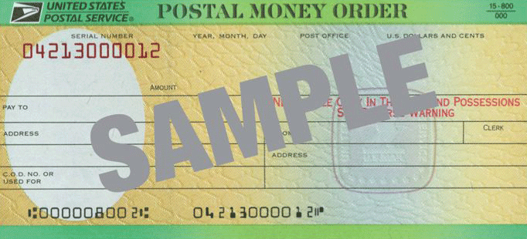
Example: USPS Money Orders
The serial number on US Postal Service money orders includes a serial number
In this case, the serial number is 04213000012 , and the last digit is a check digit

Slide 4
USPS Money Orders
A postal money order serial number is 11 digits long, including a check digit.
Add up all of the digits except the check digit.
Divide this total by 9 and find the remainder. This remainder should equal the check digit.

Slide 5
Example: 04213000012
A postal money order serial number is 11 digits long, including a check digit.
We count the digits and verify the format of our number.
Add up all of the digits except the check digit.
0+4+2+1+3+0+0+0+0+1 = 11
Divide this total by 9 and find the remainder. This remainder should equal the check digit.
11 divided by 9: goes in once, remainder 2 ✓

Slide 6
Finding Remainders
In general, how do you find the remainder when one number is divided by another?
We could always use long division, but that can sometimes be difficult
How can we use our calculators to solve this kind of problem?

Slide 7
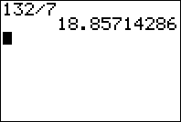
Finding Remainders
Suppose we want the remainder when 132 is divided by 7
If we type 132 divided by 7 into the calculator, we get a decimal answer
How do we use the decimal answer to find the remainder?

Slide 8
Finding Remainders
The part of our answer before the decimal point tells us that 7 goes into 132 a total of 18 times
The fact that there is stuff after the decimal point tells us that there is some nonzero remainder

Slide 9
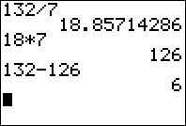
Finding Remainders
We know that 132 can be broken up into 18 groups of 7 with some left over
Using the calculator again, we see that 18 groups of 7 is 126
Now we can subtract to find the remainder, 6

Slide 10
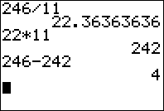
Finding Remainders
Here is another example: the remainder when 246 is divided by 11
Divide the two numbers
Take the whole number part of the answer and multiply it by the number you divided by
Then subtract to find the remainder

Slide 11
You Try It
Find these remainders:
The remainder when 1000 is divided by 27
The remainder when 1234 is divided by 11
The remainder when 143 is divided by 13

Slide 12
You Try It
Find these remainders:
The remainder when 1000 is divided by 27 is 1
The remainder when 1234 is divided by 11 is 2
The remainder when 143 is divided by 13 is 0

Slide 13
Using a Check Digit System
Now that we know how the USPS money order check digit system works, we want to use it to do these three things:
Determine whether ID numbers are valid or invalid
Create a new ID number with a correct check digit
Detect (and possibly correct) errors

Slide 14
1. Determine if an ID number is valid
We already know how to check if an ID number is valid
Simply perform the calculation to get the check digit: add up all the digits (except the check digit) and find the remainder when this total is divided by 9
Then compare your answer to see if the check digit that was given is correct

Slide 15
2. Create a new ID number
When we have an ID number, but no check digit, we need to perform the check digit calculation anyway
If the calculation does not involve the check digit, then this is easy
If the calculation does involve the check digit, think about which digit would give you the result you need

Slide 16
2. Create a new ID number
What if we wanted to create a money order with serial number 6891305915◻
The box indicates the space the check digit goes into
We calculate the digit normally: 6+8+9+1+3+0+5+9+1+5 = 47
So the check digit is 2

Slide 17
2. Create a new ID number
Suppose we have a check digit system like this:
ID numbers are 5 digits and a check digit
The sum of all the digits (including the check digit) should be 20
Which check digit should be added to 63204◻?

Slide 18
3. Detecting Errors
Let’s start with a valid money order serial number: 45910758396
We will cause a substitution error and see if the system detects it: 45910458396

Slide 19
3. Detecting Errors
Let’s start with a valid money order serial number: 45910758396
We will cause a substitution error and see if the system detects it: 45910458396
Perform the check digit calculation: 4+5+9+1+0+4+5+8+3+9 = 48
But 48 has a remainder of 3

Slide 20
3. Detecting Errors
Let’s start with a valid money order serial number: 45910758396
We will cause a substitution error and see if the system detects it: 45910458396
Perform the check digit calculation: 4+5+9+1+0+4+5+8+3+9 = 48
But 48 has a remainder of 3

Slide 21
3. Detecting Errors
Since the calculated check digit didn’t match the actual check digit, we know that the serial number is not valid
So the error was detected
Can this check digit system detect all substitution errors?

Slide 22
3. Detecting Errors
Remember that our original serial number is 45910758396
Let’s cause a different substitution error: 45010758396
We calculate: 4+5+0+1+0+7+5+8+3+9 = 42, which leaves a remainder of 6

Slide 23
3. Detecting Errors
Remember that our original serial number is 45910758396
Let’s cause a different substitution error: 45010758396
We calculate: 4+5+0+1+0+7+5+8+3+9 = 42, which leaves a remainder of 6

Slide 24
3. Detecting Errors
The new ID number is valid, which means the error we caused was not detected
In fact, any time we replace a 0 with a 9 (or vice versa) in this system, that error cannot be detected
However, any other single-digit substitution error will be detected

Slide 25
3. Detecting Errors
What about transposition errors? Again we’ll start with our valid ID number: 45910758396
Suppose we get 45910785396
If we calculate the check digit of this new number, we get 4+5+9+1+0+7+8+5+3+9 = 51, which leaves a remainder of 6

Slide 26
3. Detecting Errors
What about transposition errors? Again we’ll start with our valid ID number: 45910758396
Suppose we get 45910785396
If we calculate the check digit of this new number, we get 4+5+9+1+0+7+8+5+3+9 = 51, which leaves a remainder of 6

Slide 27
3. Detecting Errors
The transposition error was not detected because the check digit system only looks at the sum of the first 10 digits
So any rearrangement of the first 10 digits of a valid money order serial number will result in another valid number
We will have to look at a different kind of check digit system to detect transposition errors

Slide 28
3. Correcting Errors
Earlier, we were able to detect that 45910458396 is not a valid ID number
We caused a substitution error, but if we didn’t know the original ID number, would there be any way of recovering it from this one?
Unfortunately, the “bad” digit could be anywhere

Slide 29
3. Correcting Errors
Suppose you are given this serial number: 13598712658
We can easily determine that this number is invalid: 1+3+5+9+8+7+1+2+6+5 = 47, which leaves a remainder of 2
However, there is no way to get the original serial number from this information

Slide 30
3. Correcting Errors
Suppose you are given this serial number: 13598712658
Now suppose you are told that the third digit is the one that is incorrect

Slide 31
3. Correcting Errors
Suppose you are given this serial number: 13598712658
Now suppose you are told that the third digit is the one that is incorrect
In fact, since we know that digit is wrong, we might as well replace it with an empty box

Slide 32
3. Correcting Errors
Suppose you are given this serial number: 13◻98712658
Can we determine which number belongs in the box?

Slide 33
3. Correcting Errors
Suppose you are given this serial number: 13◻98712658
Can we determine which number belongs in the box?
Let’s calculate the check digit: 1+3+?+9+8+7+1+2+6+5 = 42 + ?

Slide 34
3. Correcting Errors
Suppose you are given this serial number: 13◻98712658
Now 42 + ? should have a remainder of 8 when divided by 9
By itself, 42 has a remainder of 6, so what could we add to 42 to get a remainder of 8?

Slide 35
3. Correcting Errors
This reasoning gives us 13298712658
Let’s check our answer: 1+3+2+9+8+7+1+2+6+5 = 44, which leaves a remainder of 8 ✓

Slide 36
3. Correcting Errors
As we have seen, in certain situations we will be able to not only detect an error, but also correct it
This is a very valuable tool, but in our example, we needed a key piece of information: the location and type of error
Later in this unit we will study ways to correct errors without that extra information

